Slide 1
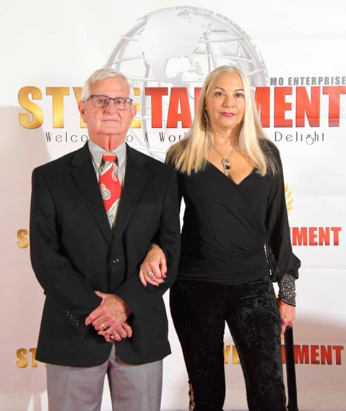

Ada
Russel Hoge and Jill Paul
It is truly our privilege to present you with the prestigious Ada Award, in memory of Missouri’s Mother. We hope you will accept this great honor.
We love you.
Words are never enough for what the two of you did for Missouri our Mother.
LOVE.
Missouri, Family and We are
STYLETAINMENT

Slide 2
Hattie Kathleen Smith
Congratulations 2023
Ada AWARD
RECIPIENT

Slide 3
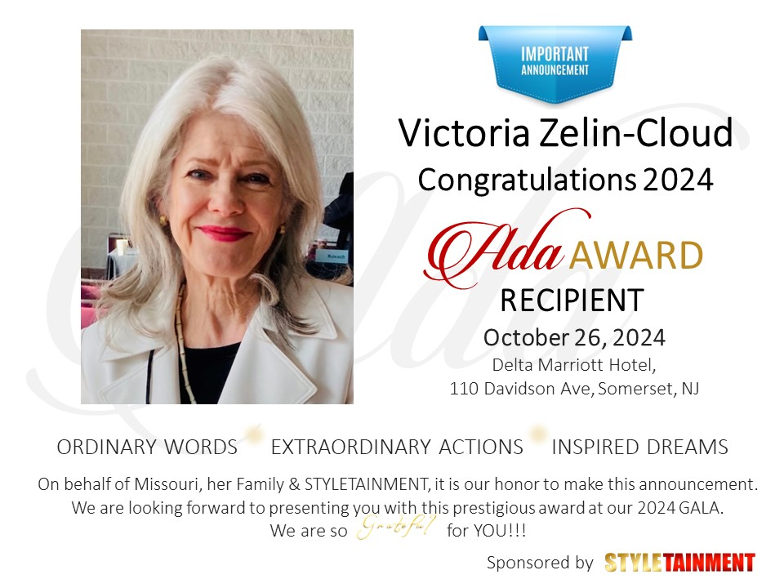

Slide 4
